Slide 1
TRP RATING FOR TELECOMMUNICATION SERVICE
FROM
17911A05K6
17911A05L2
17911A05M0
17911A05N0

Slide 2
ABSTRACT
Television rating point is a tool provided to judge which programmers are viewed the most and gives us an index of the choice of the people. Advertising broadcasting and media agencies has large amount of interest in rating agencies program availability, scheduling of program and advertiser’s.
TRP rating the absolute rating gained by any program reliability. And accountability of rating are to be taken in consideration with the ever increasing of a person or programme and they can know the TRP rating and about the person through this application instantly.
Rating scale is an important technique of evaluation rating is the assessments of a person by another person. In this scale and inventories come under the trail approach

Slide 3
CONTENTS
Structures:-The arrangement of and relations between the parts or elements of something complex.
Files:-A file represents a sequence of bytes on the disk where a group of related data is stored, File is created for permanent storage of data and also it is a ready made structure.
Arrays:-An arrays is a collection of data items, all of the same type, accessed using a common name.

Slide 4
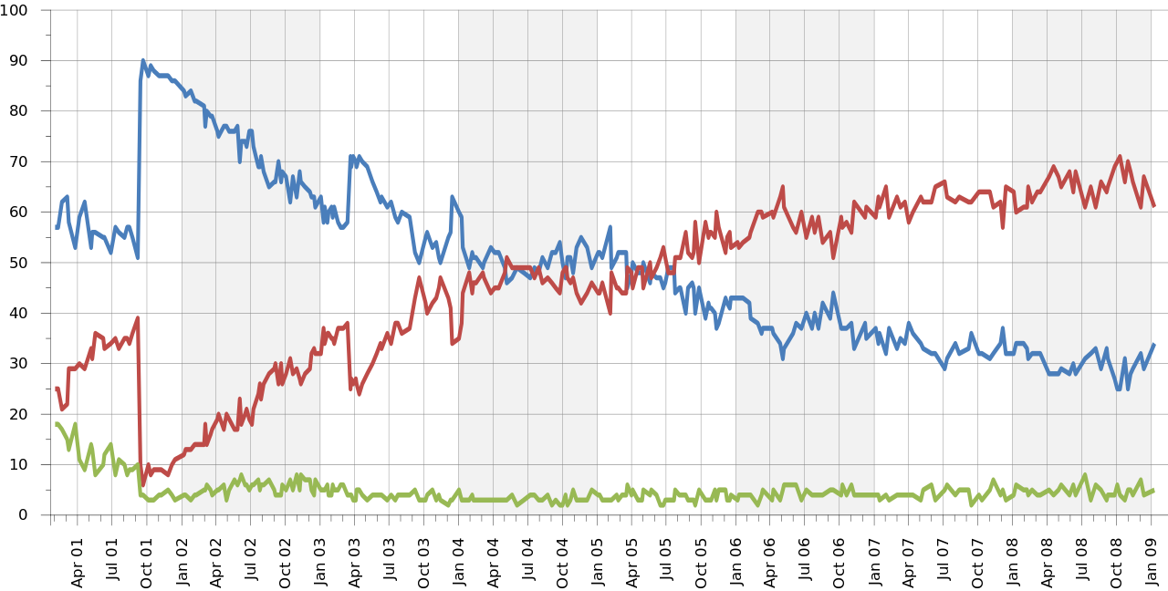

Slide 5
INTRODUCTION ABOUT TRP RATINGS
Television Rating Point(TRP) is a tool provided to judge which programmers are viewed the most. This gives us an index of the choice of the people and also the popularity of a particular channel. For calculation purpose, a device is attached to the TV set in a few thousand viewers houses for judging purpose. These number are treated as a sample from the overall TV owners in different geographical and demographic sectors

Slide 6
HARDWARE REQUIREMENTS
System :- Intel core i5(7th Gen)
Hard Disk :- 120 GB
Monitor :- 15” LED
Input Device :- Keyboard, Mouse
Ram :- 4GB

Slide 7
SOFTWARE REQUIREMENTS
Operating System :- Windows 10
Coding Language :- C
Tool :- Dev C++,Turbo++

Slide 8
EXISTING SYSTEM
Exposure to people who wish to do well in the entertainment industry.
Teach you the exactly how not to behave in public.
Provide employment to poor workers who work in the entertainment industry.
The poor background winner can get some money.

Slide 9
PROPOSED SYSTEM
Now a days we are seeing so many TV programmes which are casting every single second so I proposed a system to make a competition between the one media to the another media.
When we take the average of the program which is casting given by the customer. The average should be greater than the “8”.
S0 I just make the competition between the one media to the another media the which media will be is first palce.

Slide 10
IMPLEMENTATION
This program provides two interface. They are one for the viewers and the another one for the media interface. If you are the viewer there will be different programmes to rate according to the age group.
In the age group also one is less than eighteen and the another interface is greater than the eighteen.
This two age groups will have different programs to give there rating.at the internal of the program it will take the average of the all the inputs which are given by the user. And stored in respective there files.

Slide 11
If you are a media interface and you want to see the average rating which the customers are given. You must enter the password which is given for different media interface different passwords are given.
If the password is matches then the media interface can see there average rating of the programme. And also another password is given for the competition purpose. To check at which place the program is there and what the media should add to come to first place.
As it a competition world every media interface programme should be average above “8”.
As the rating is more for the media, it will get more profit than another media interface. More ratings more money

Slide 12
CONCLUSION
The final output of the program is
Enter whether your customer or provider
If customer
Enter to which u want to rate the program
1)BIG BOSS
2)DHEE 10
1

Slide 13
enter the rating between 1-10
8
Repeat this process how many customer want to give the rating
At the final stage take the average of the customer
After the taking the average it will send to the provider
If the provider enter the correct pin the output is displayed the average
If the average is below 8 “ the provider should telecast the new series to improve the rating “
If the average is below 8” the program is fantastic the program should be constant and to do some modification to be in the first place “

Slide 14

QUERIES

Slide 15


